Slide 1

VANDVY
BLOOD DONOR MANAGEMENT SYSTEM

Slide 2


TABLE OF CONTENTS
Division of tasks
Project goals and significance
Research and Project requirements
Program functions
Demo
Q&A and Feedback

Slide 3

GROUP MEMBERS
Trần Xuân Bảo Việt
Nguyễn Quốc Nhựt
Cao Ngọc Ý
Võ Mai Khả Vi
Nguyễn Thị Tú Anh
Trần Huy Dương

Slide 4

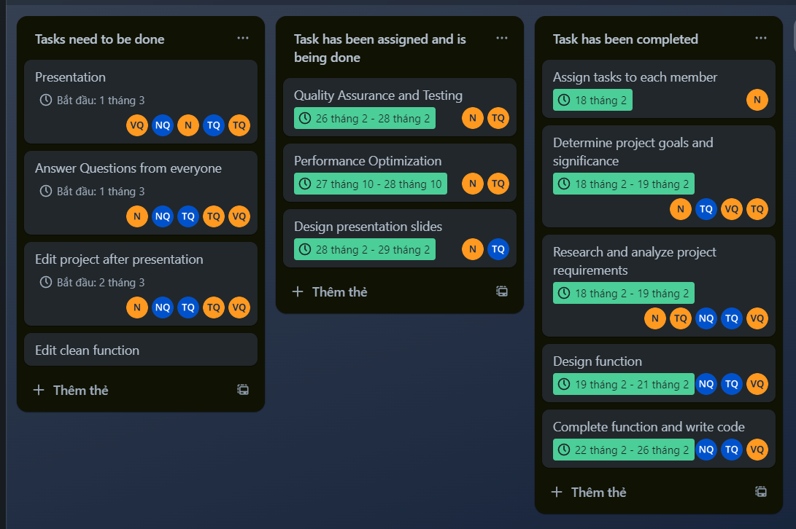
DIVISION OF TASKS

Slide 5


Project Goals
Efficient Information Management
Real-time Accessibility
PROJECT GOALS AND SIGNIFICANCE
Project Significance
Able to respond quickly in emergency situations
Provides key information to optimize blood management processes.

Slide 6


RESEARCH AND PROJECT REQUIREMENTS
Use the following structure types:
LinkedList
Stack
Queue – Deque – PriorityQueue
Tree – Binary Tree – Balanced Search Tree - AVL Tree
Heap
Graph

Slide 7
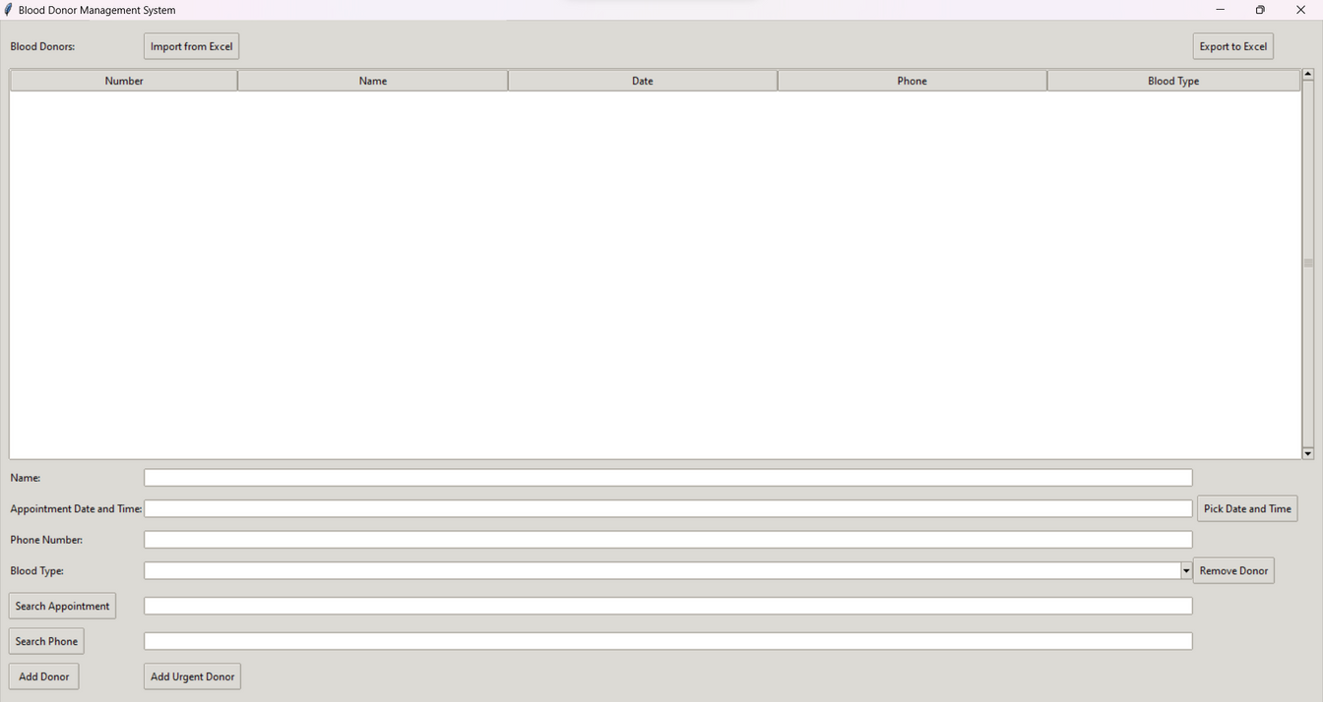
FUNCTIONS OF PROGRAM
01
Insert donor
02
Search appointment time
03
Insert urgent donor
04
Search phone number
05
Filter blood type
06
Remove donor

Slide 8
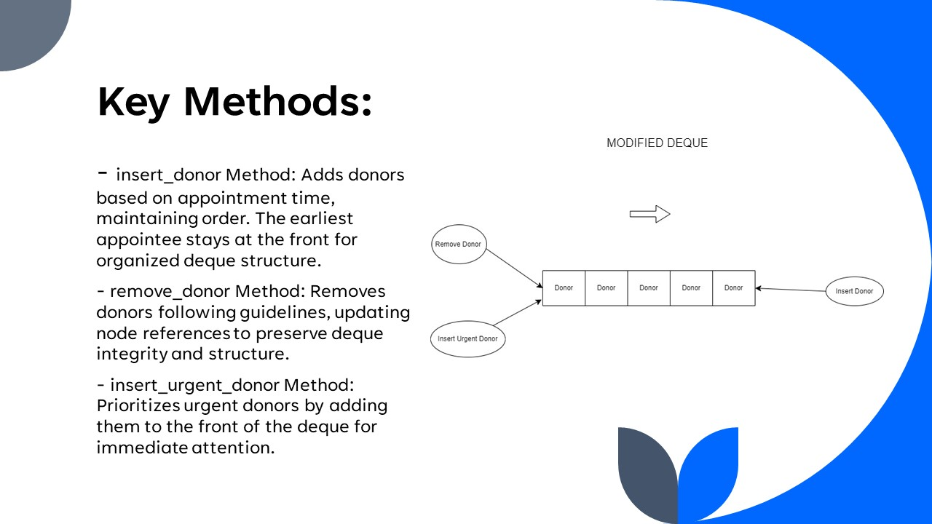

Slide 9
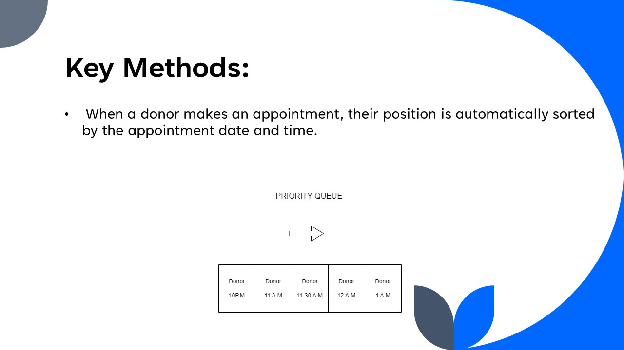

Slide 10
DEMO AND Q&A

Slide 11




THANK YOU
Quy Nhon - Binh Dinh
0862435347
www.csd203.com
We look forward to working with you

